Slide 1
Happy People
Anna Brown, Josh Chung, Alex Snyder, Kim McKeever

Slide 2
Core Idea: Analysis of employee reviews within the “Big 5”.
Which of the subcategories impacted the overall rating the most?
Reason: In order to find which factor effected the overall rating the most?
Result:
Are there were any common themes in what people like about their jobs?
Reason: What do people like and dislike about their jobs based on written reviews?
Result:
Do unemployment rates have an impact on overall job ratings?
Reason: Are people happier with their jobs when more people are unemployed?
Result: Yes, people rate their jobs more poorly when unemployment rates are high.
Does company success have an impact on employee satisfaction?
Reason: do successful companies attract (or create) happier employees?
Result:

Slide 3
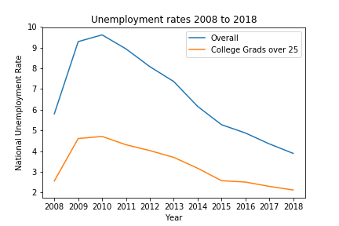
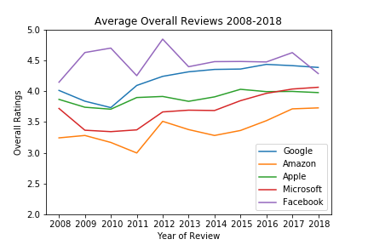
Unemployment and Job Reviews
Data Cleanup & Exploration
Originally planned to use API from Bureau of Labor Statistics however there were issues.
Made minor improvements to spreadsheet.

Slide 4
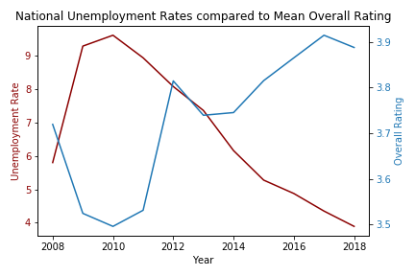
Unemployment Data Analysis
After reviewing the individual graphs, I combined them to compare the overall rating to the overall national unemployment rate
Notes:
Numbers=facebook in particular

Slide 5
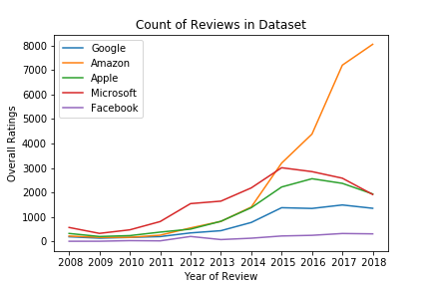
Unemployment Discussion
Limitations
Glassdoor started in mid-2007 and was therefore less well-known during the “Great Recession” As a result, numbers were low.
People who unhappy or very happy with an experience are most likely to seek out review services.
An increase in focus on Glassdoor reviews could lead happy employees to want to increase their overall ratings
Based on the graph below, it would appear that unemployment does majorly affect overall job ratings.

Slide 6
Unemployment Post Mortem
Difficulties:
Unusual values in the dataset
BLS API
Further Questions:
Former vs. Current Employees (especially around times of high unemployment)
More companies around 2009-2010
Different review sites.

